Slide 1
Network Information Retrieval
chenxuan@njtech.edu.cn

Slide 2
Baidu

Slide 3
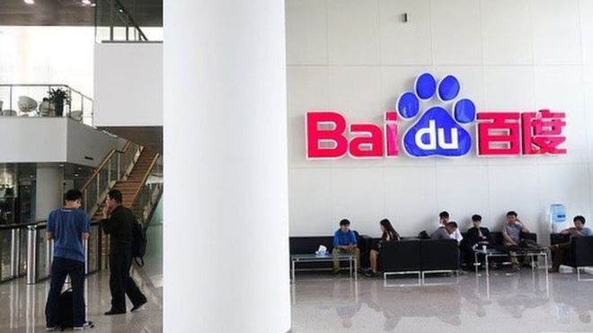
Wei Zexi

Slide 4
SE ( Search Engine)
Photo Search
search box
Baidu Search

Slide 5
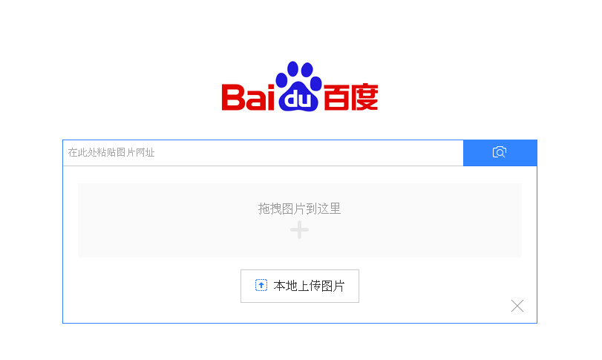
SE ( Search Engine)
website
Drag the pic here.
Upload the local pic .

Slide 6
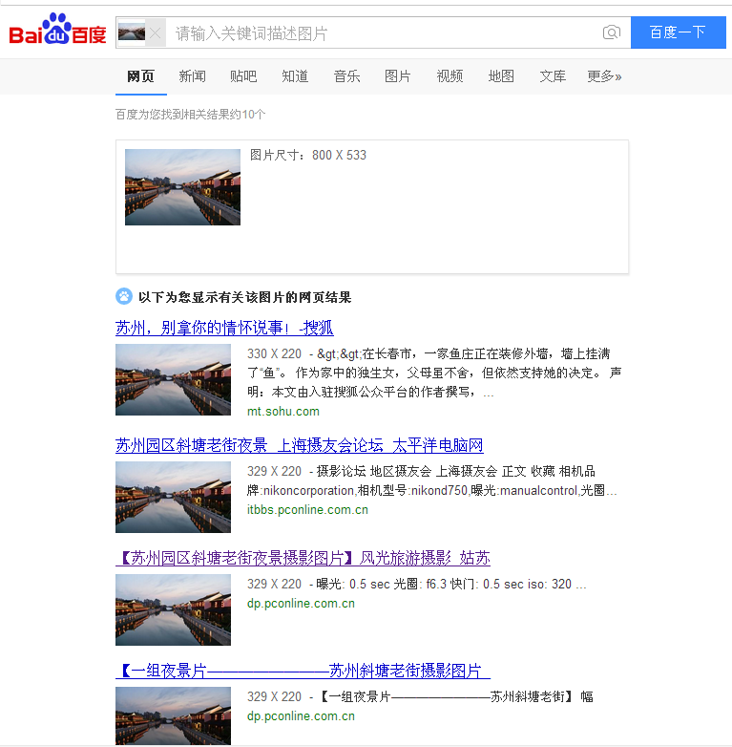
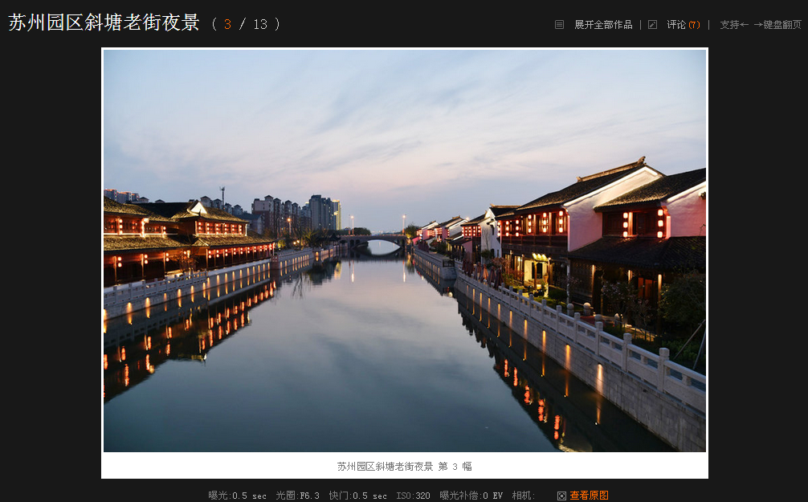
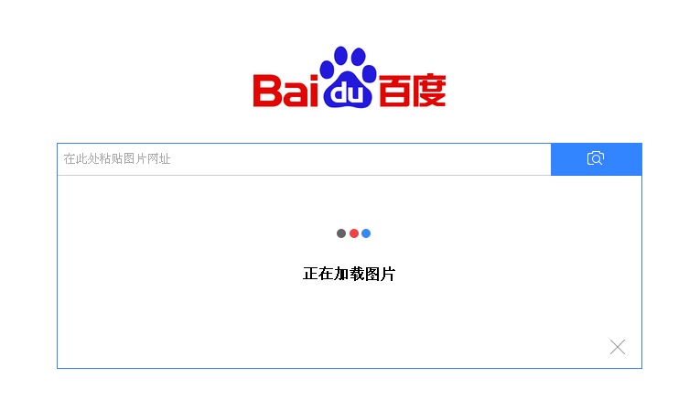

Slide 7
Baidu helps you to find out the Chinese characters you don't know.

Slide 8
settings

Slide 9
Input
method
Handwriting
Pin Yin

Slide 10
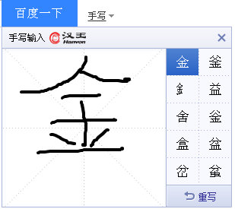

Slide 12
Google

Slide 13
GOOGLE
◆ GOOGLE SCHOLAR
◆ GOOGLE BOOKS
◆ GOOGLE TRANSLATE
◆ GOOGLE EARTH
◆ GOOGLE PLAY

Slide 14
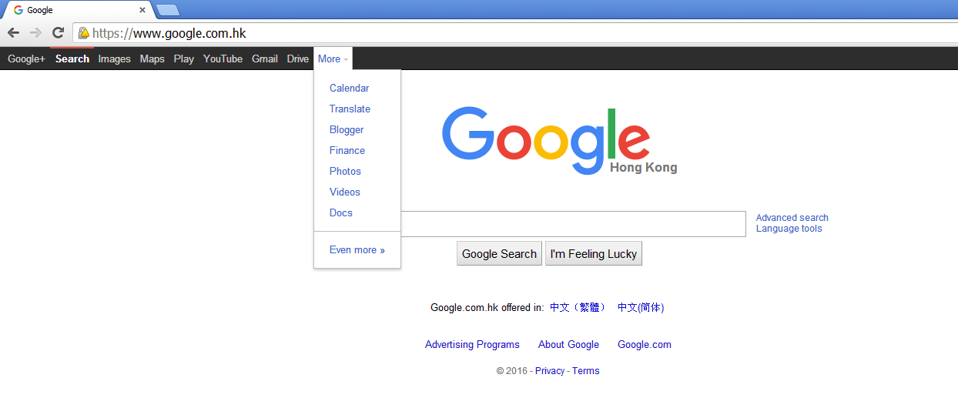

Slide 15
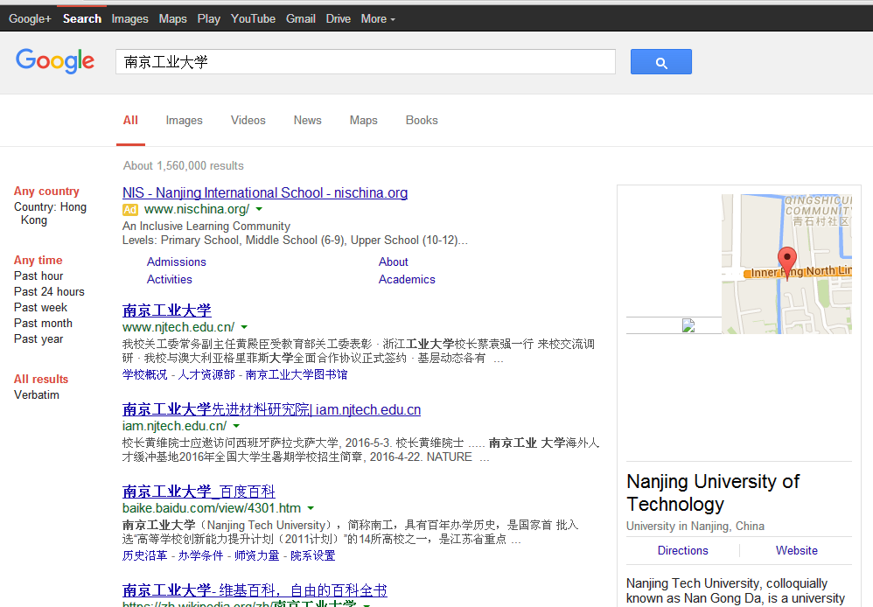

Slide 16
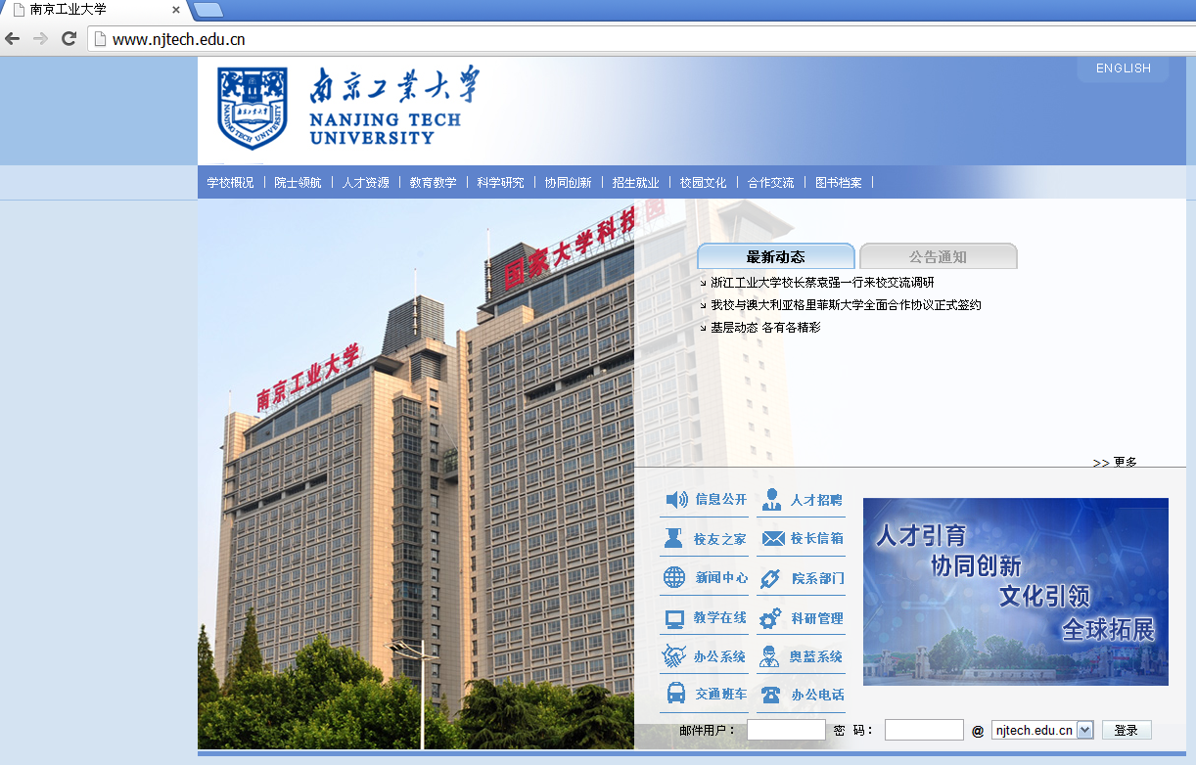

Slide 17
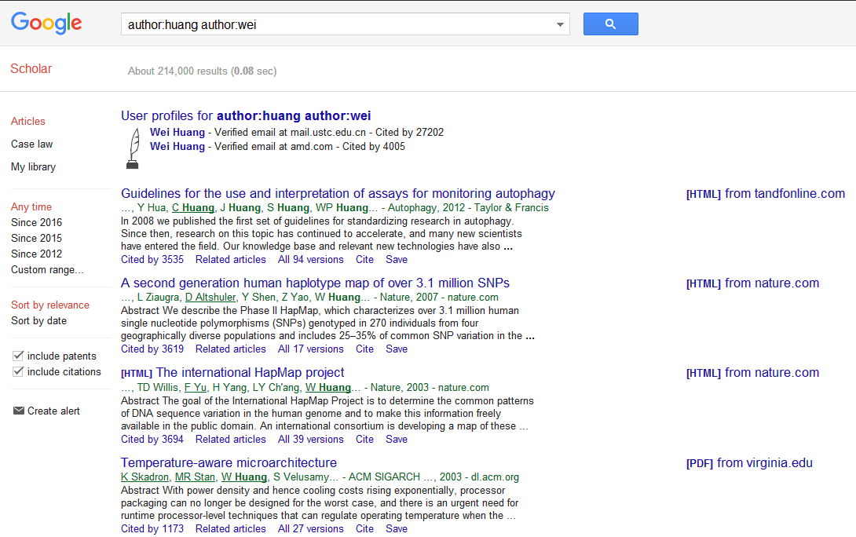
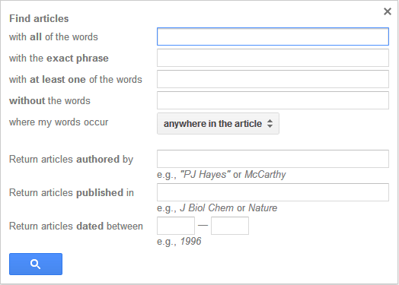
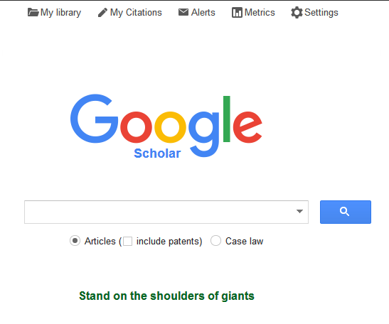

Slide 18
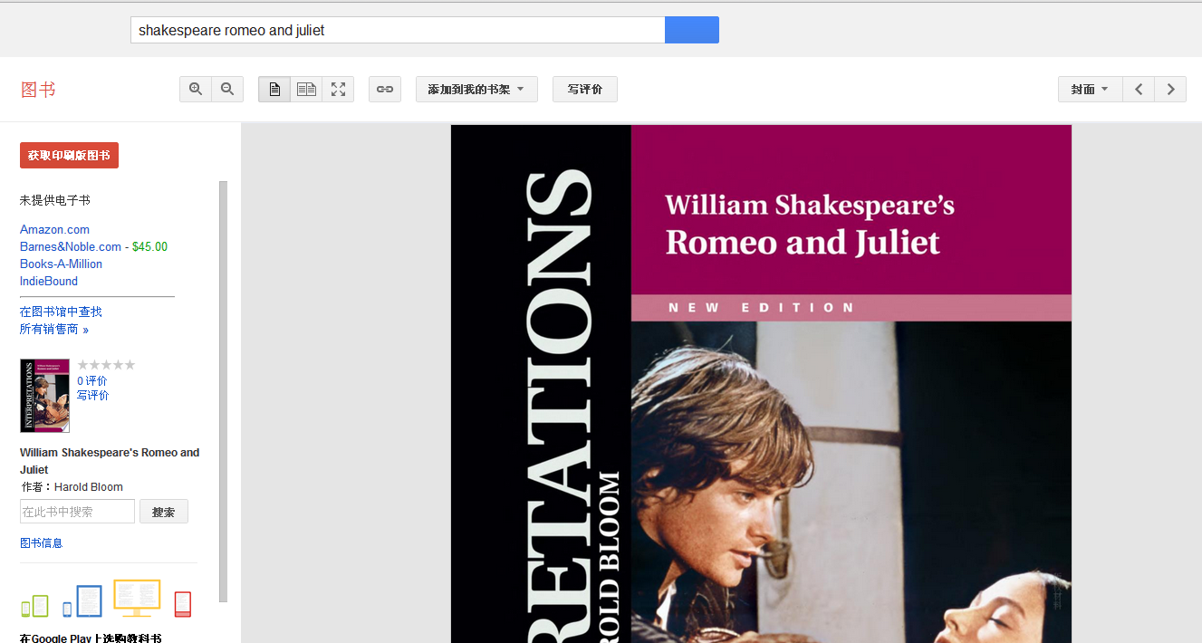
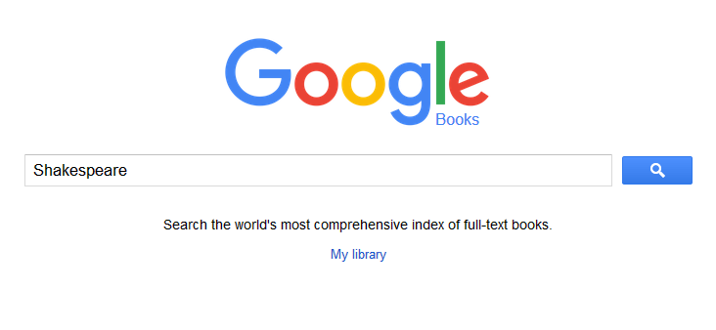
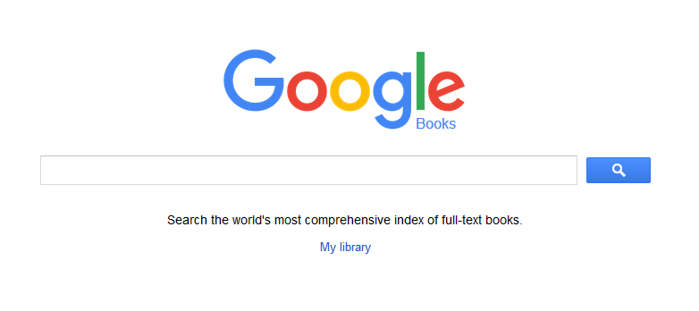
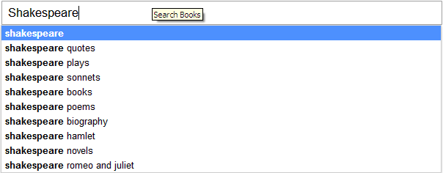
get P-books
search in the book

