Slide 1
Information Retrieval
DATABASE 2
chenxuan@njtech.edu.cn

Slide 2
Search Operators

Slide 3
Use search operators in query
Enter terms connected with search operators (AND, OR, NOT). Principle 1
To look for an exact phrase, use quotation marks. Example: "global warming" Principle2
Enter complete words and phrases or partial words and phrases using wildcards (* ?) to Truncate Principle3

Slide 4
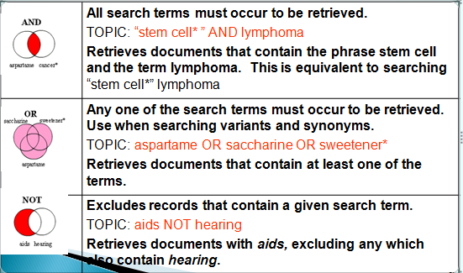
Search operators in query
Principle1: Basic search operators(boolean logic) And Or Not

Slide 5
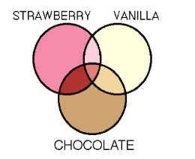
Ques:
Icecream contains all 3 tastes
Icecream contains any taste
Icecream contains strawberry or vanilla but no chocolate

Slide 6
So……….
To broaden a search, or to allow for variant spellings, combine terms using OR (results contain any specified term).
To narrow the scope of a search, combine terms using AND (results contain all specified terms).
To eliminate terms from a search, use the NOT operator.

Slide 7
Eliminate stop words in query
Stop words are the words that have no exact search means.
Such as Article(a, an, the), Preposition(of, in, for, through) , Pronouns (they, she, he ) that are meaningless when use them alone.

Slide 8
Principle3: Truncate
Symbol | Retrieve result
Wildcard ? | One character only eg en?oblast : entoblast endoblast
Wildcard *(asterisk) | zero or more characters eg gene* : gene genetics generation

Slide 9
Search exmaples
"Water consumption" finds records containing the exact phrase water consumption.
Water AND consumption finds records containing the words water and consumption.
The two words may appear in the same Topic field or they may be in different Topic fields.

Slide 10
Search exmaples
Water consumption (without quotation marks) is equivalent to the search Water AND consumption .
Water AND consum* finds records containing the words water, consume, consumed, consumer, consumption, and so on.

Slide 11
Search exmaples
*Water AND consumption finds records containing the words water, freshwater, saltwater, seawater, and consumption.
Water OR consumption finds records containing either water or consumption or both words.

Slide 12
Homework
Choose 2 databases , find out all the articles about :
Year: 2000-2016
subject: organizational behavior
Select 1 which you think is the most useful and download the text.
Homework in PPT
---details about how to find the document ( keyword, search term,strategy, etc)
---no cheating no copy
chenxuan@njtech.edu.cn

