Slide 1
Information Retrieval
chenxuan@njtech.edu.cn

Slide 2
Free Online Courses

Slide 3
MOOC
Course platform
Distribution platform

Slide 4
coursera

Slide 5
https://www.coursera.org
Take free online classes from 120+ top universities and educational organizations. We partner with schools like Stanford, Yale, Princeton, and others.

Slide 6
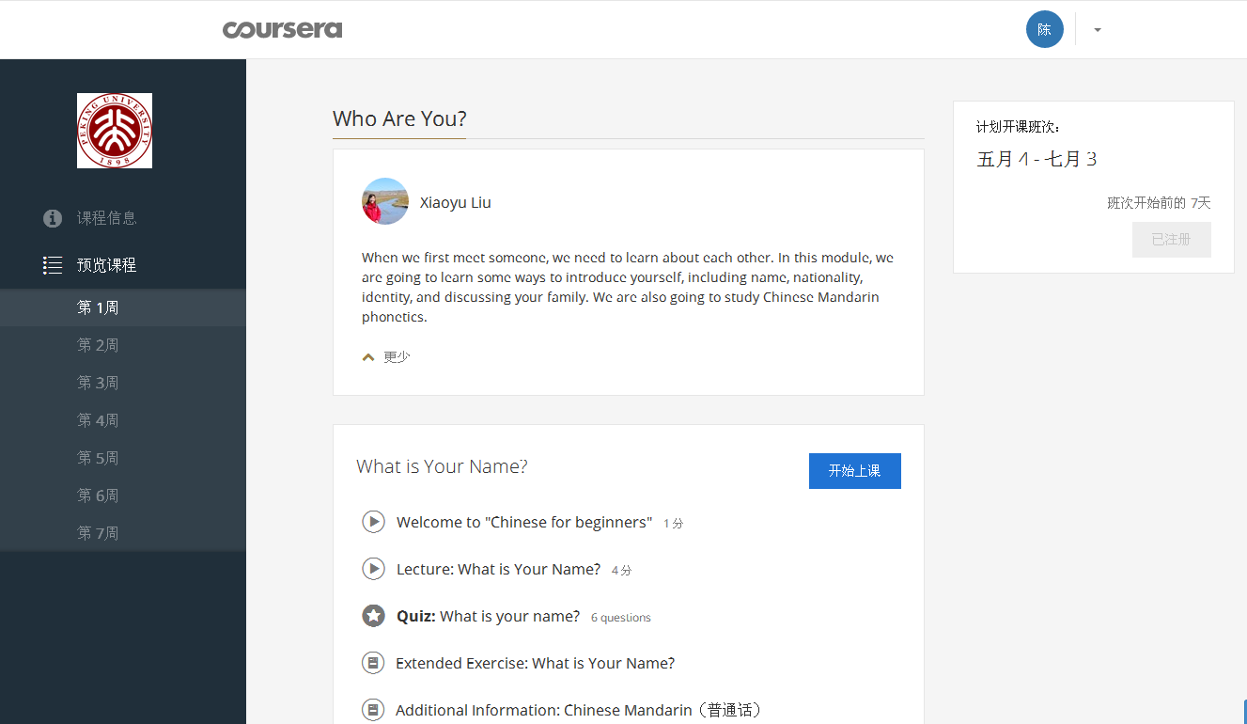
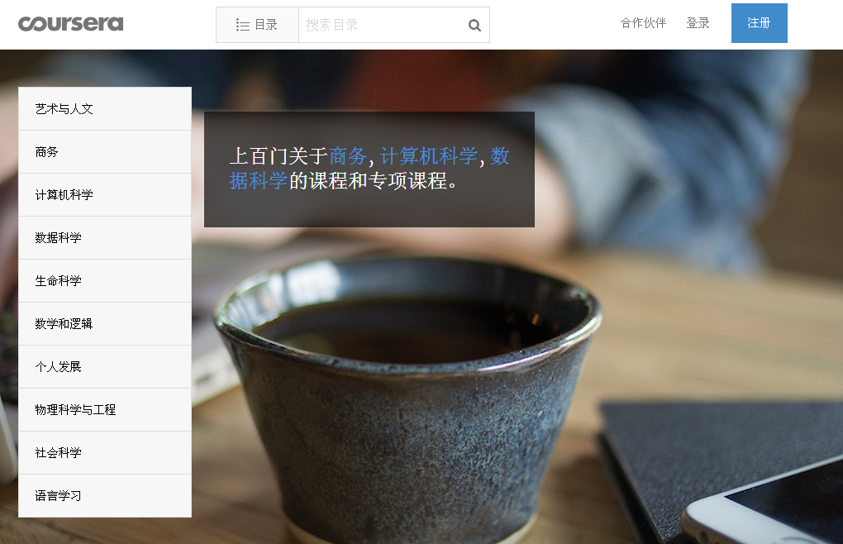
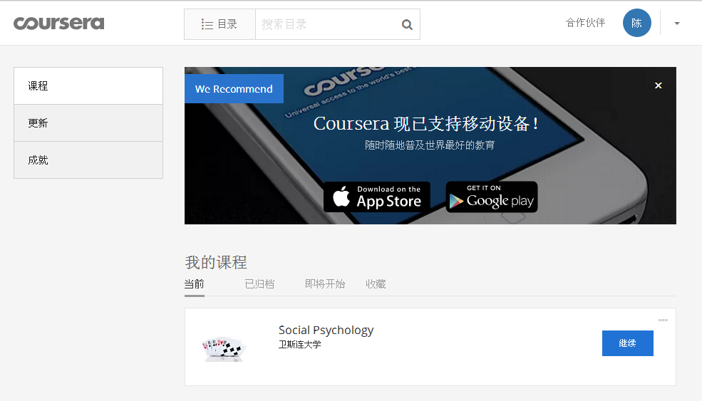
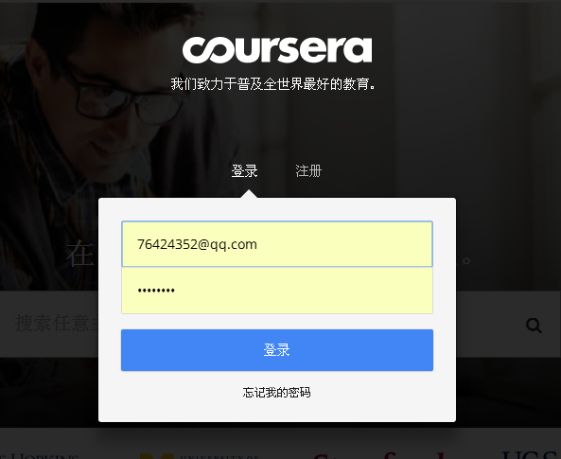
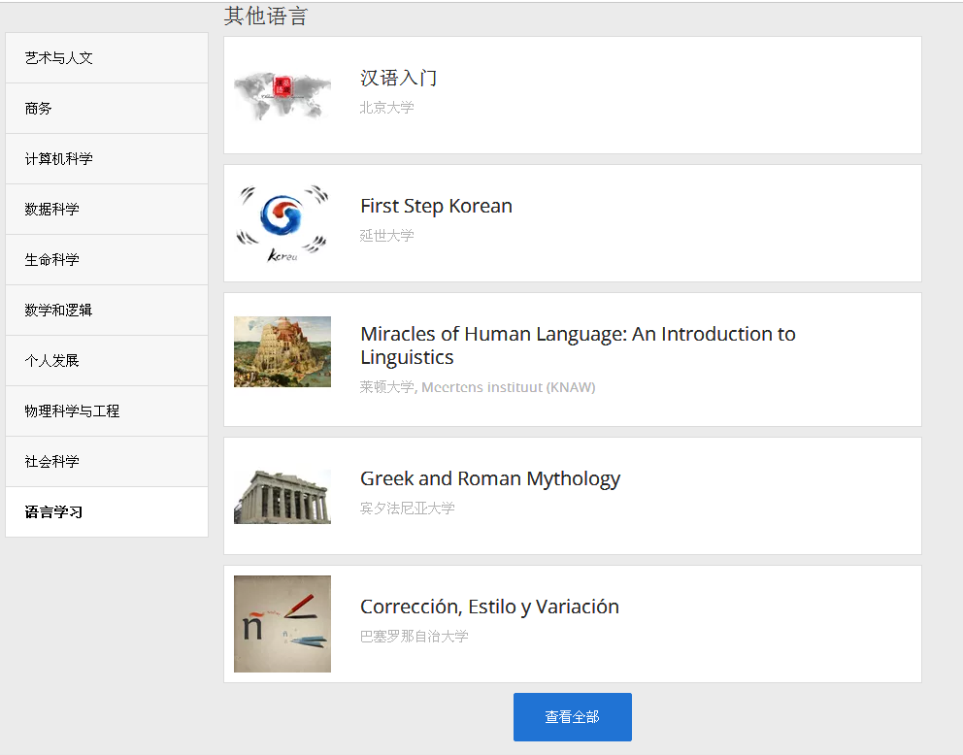
login
register

Slide 7
edX

Slide 8
https://www.edx.org/

Slide 9
Future Learn

Slide 11
https://www.futurelearn.com
Choose from hundreds of free online courses: from Language & Culture to Business & Management; Science & Technology to Health & Psychology.
Meet educators from top universities and cultural institutions, who'll share their experience through videos, articles, quizzes and discussions.

Slide 12
NovoEd

Slide 13
https://novoed.com/

Slide 14
Универсариум

Slide 15
http://universarium.org/

Slide 16
Stanford Online

Slide 17
https://lagunita.stanford.edu/
Lagunita is Stanford's instance of the open-source software release of the Open edX platform, which was developed by the joint Harvard/MIT non-profit organization, and which Stanford engineers have been collaborating on since April 2013. Lagunita hosts many of the free, online courses that are taught by Stanford faculty and made available to lifelong learners around the world for self-enrichment. Lagunita also hosts a variety of professional education opportunities in conjunction with many of Stanford University's schools and departments.

Slide 18
MIT Open Courseware

Slide 19
http://ocw.mit.edu/index.htm

Slide 20
果壳网

Slide 21
http://mooc.guokr.com/

Slide 23
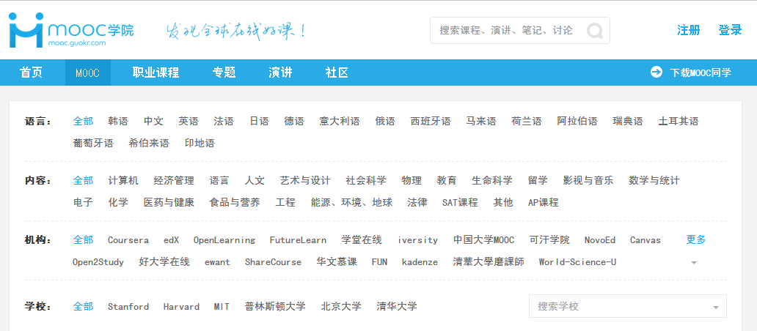
language
content

Slide 24
Homework
Register at least one MOOC platform, choose some courses that interested.

