Slide 1
Information Retrieval and Office Software Application
chenxuan@njtech.edu.cn

Slide 2
Review
WHAT
WHY
HOW
WHO

Slide 3
LIBRARY

Slide 4
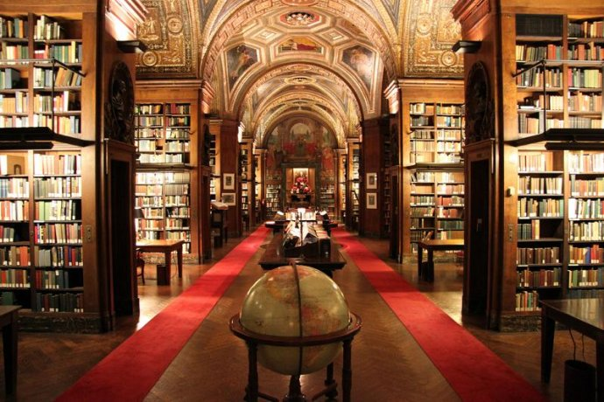
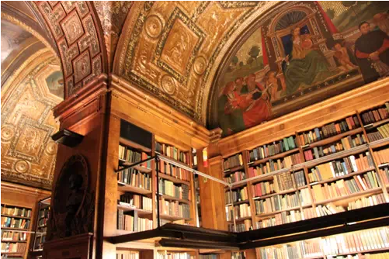
University Club Library–New York City, United States

Slide 5
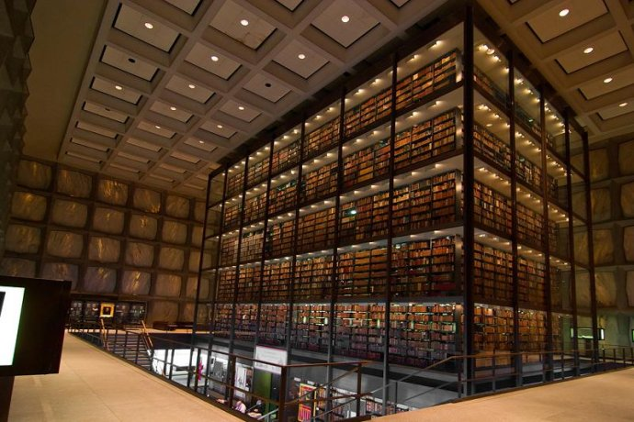
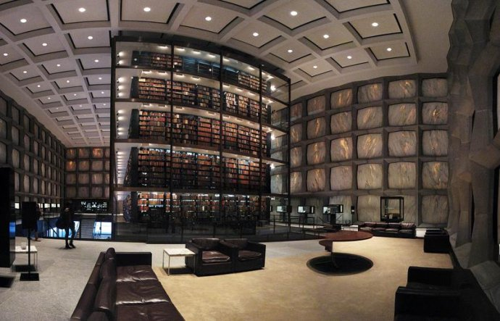
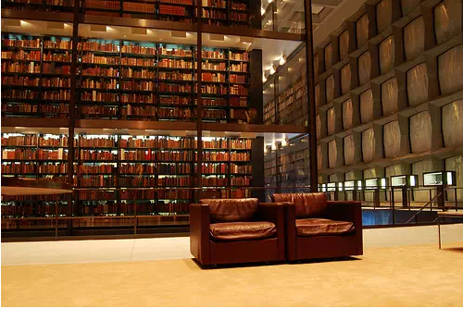
Yale University’s Beinecke Rare Book and Manuscript Library-New Haven, Connecticut

Slide 6
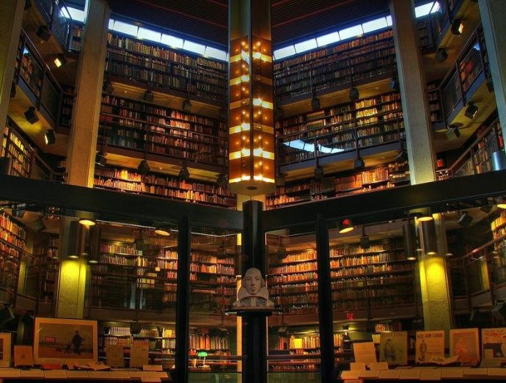
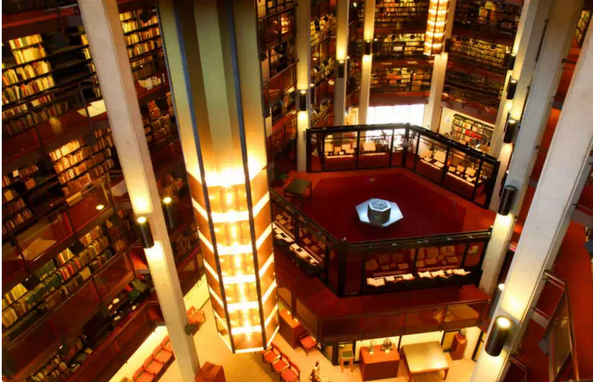
Thomas Fisher Rare Book Library at University of Toronto – Toronto, Canada

Slide 7
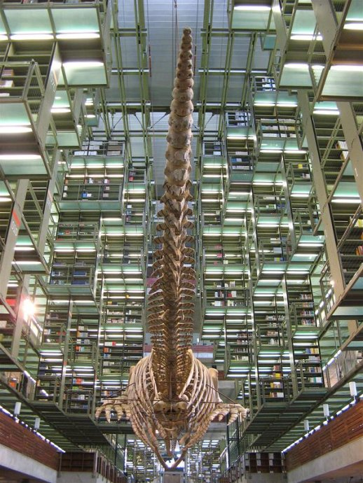
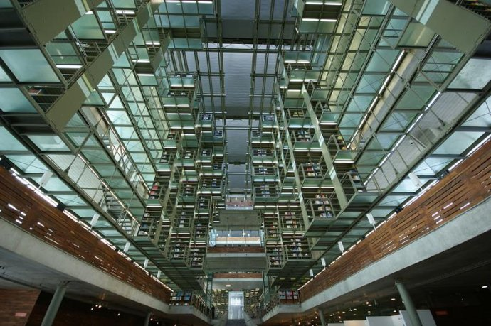
José Vasconcelos Library–Mexico City

Slide 8
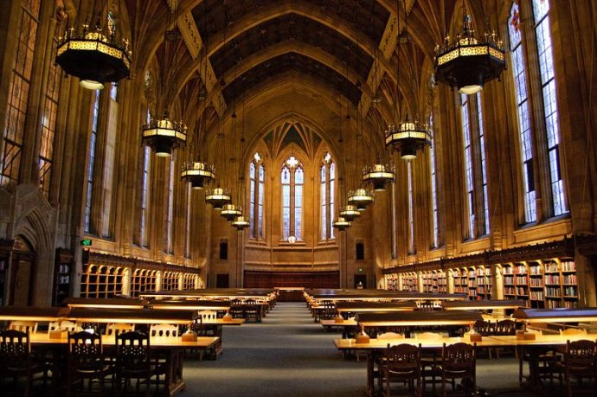
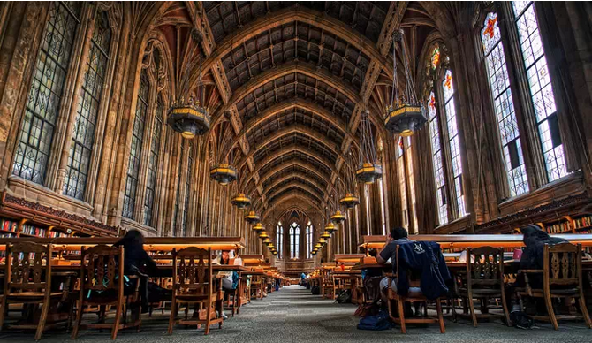
Suzzalo Library at the University of Washington–Seattle, Washington Suzzalo

Slide 9
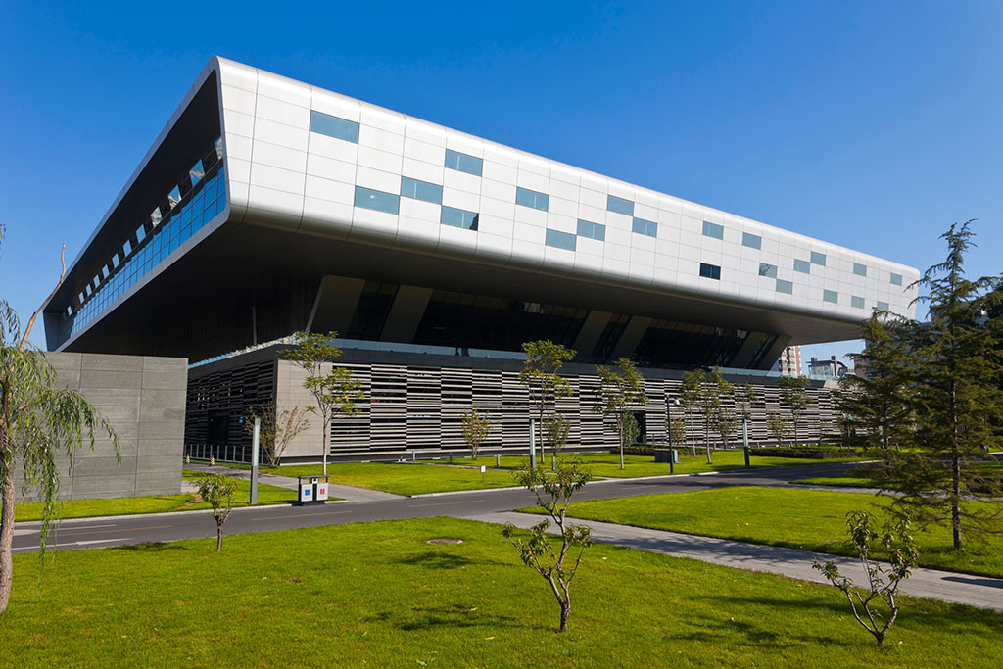
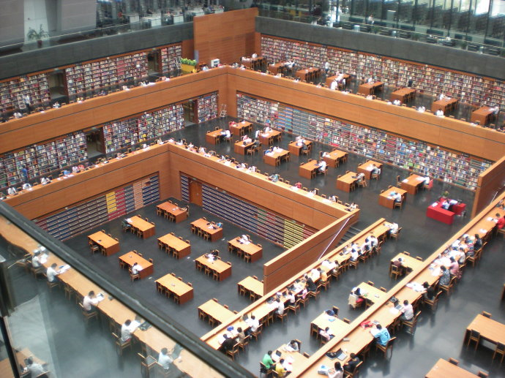
National Library of China

Slide 10
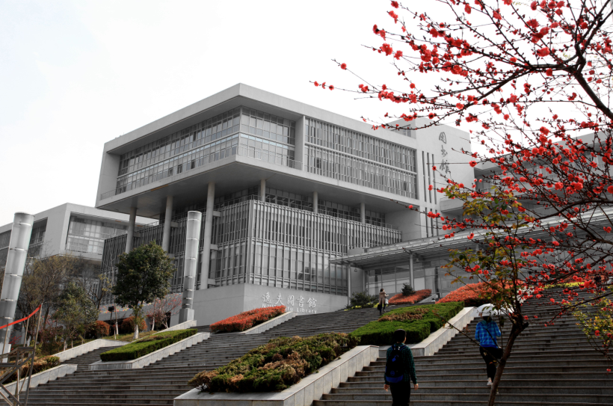
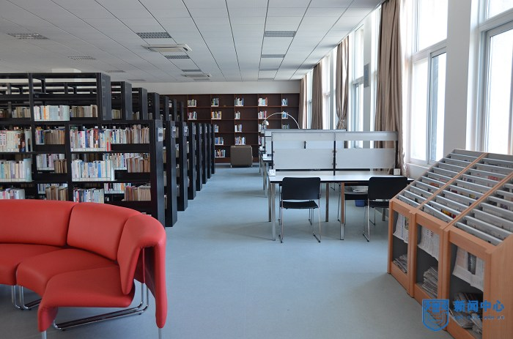
Library of NJTECH

Slide 11
Books and databases
Study lounges
Oversea students service center
Students' activity
For Free
For Special
Why need to know library?

Slide 12
How to use library?

Slide 13
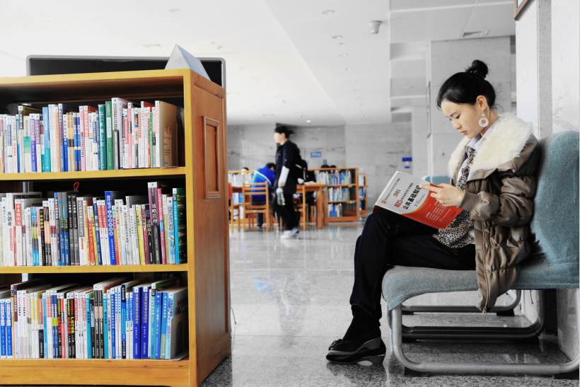
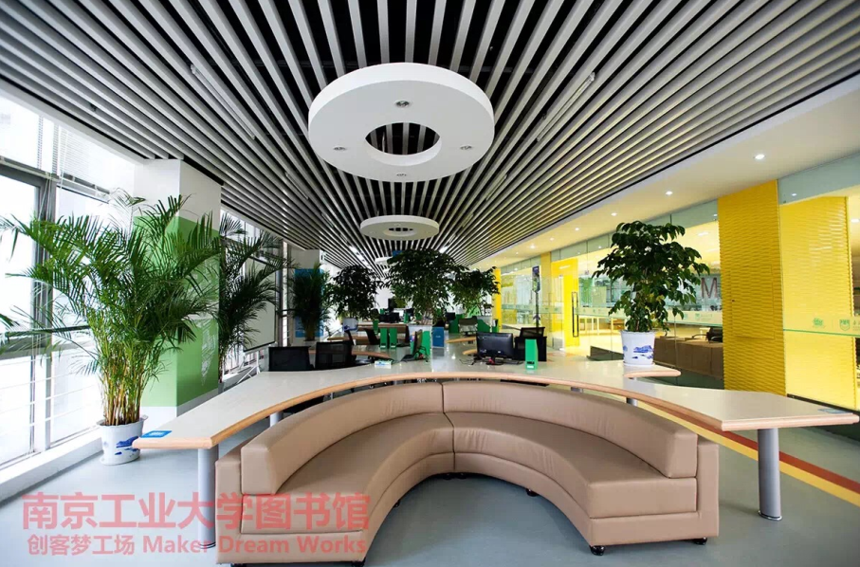
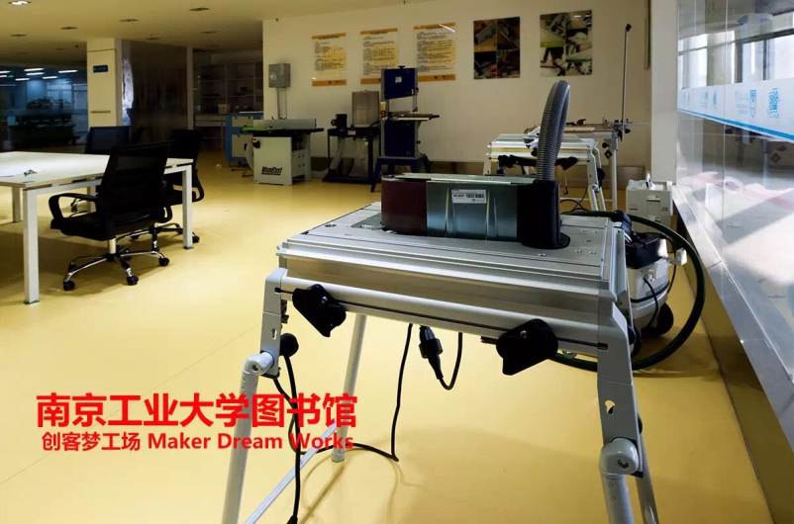
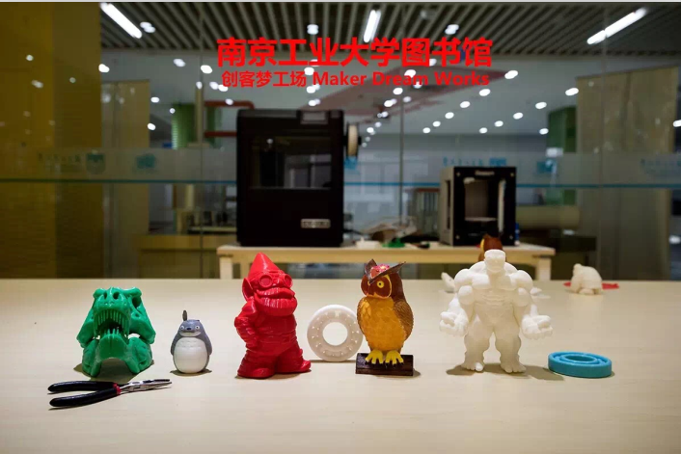
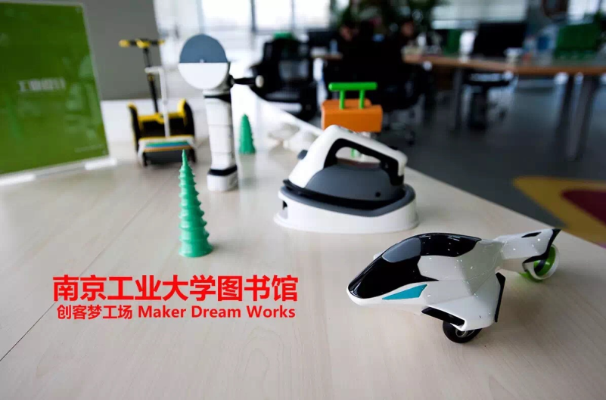
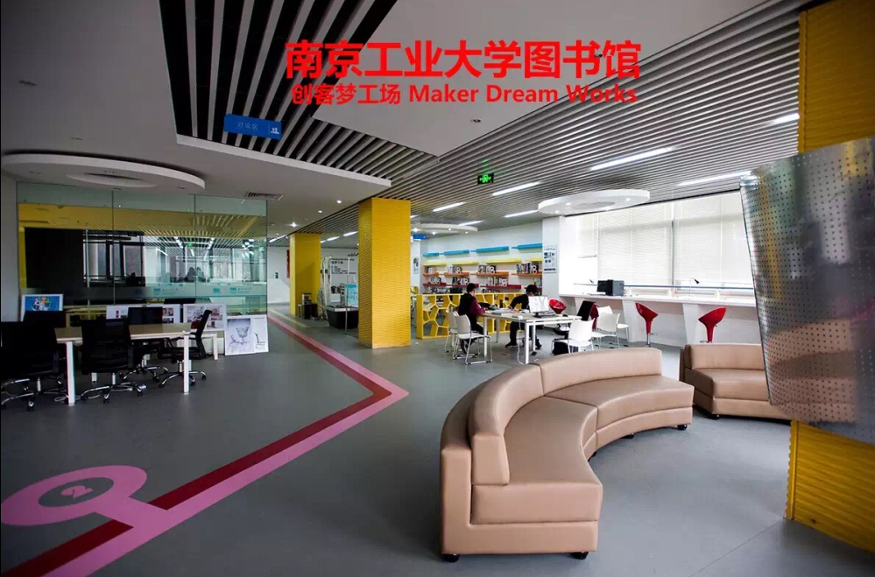
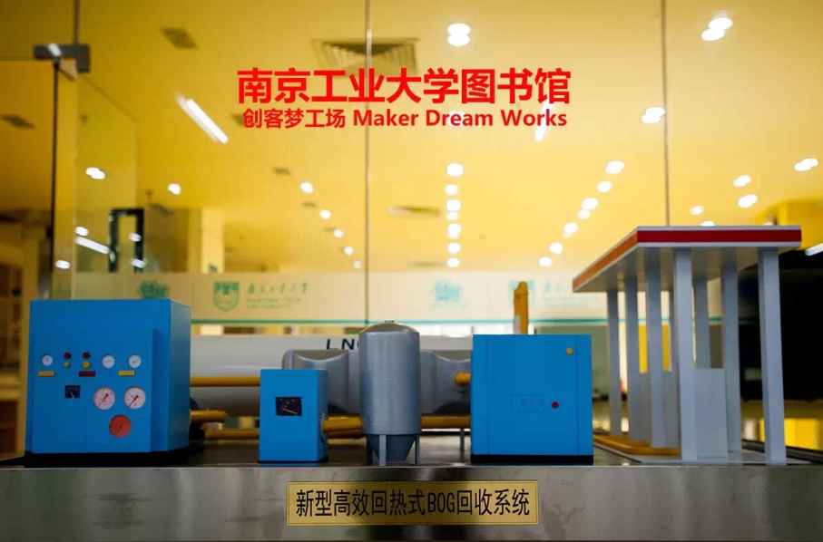
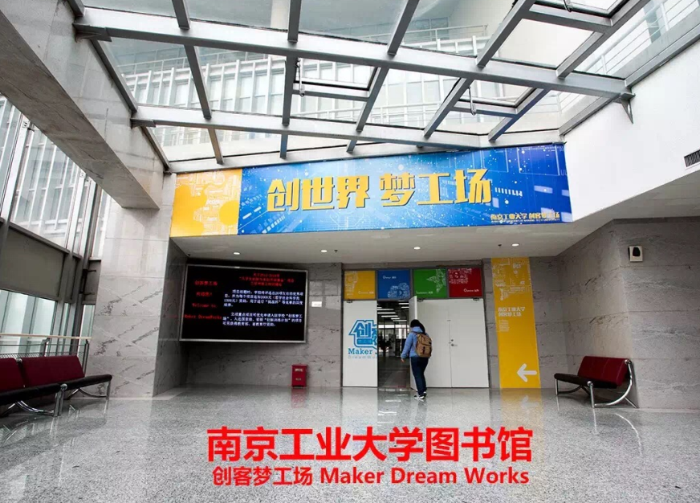
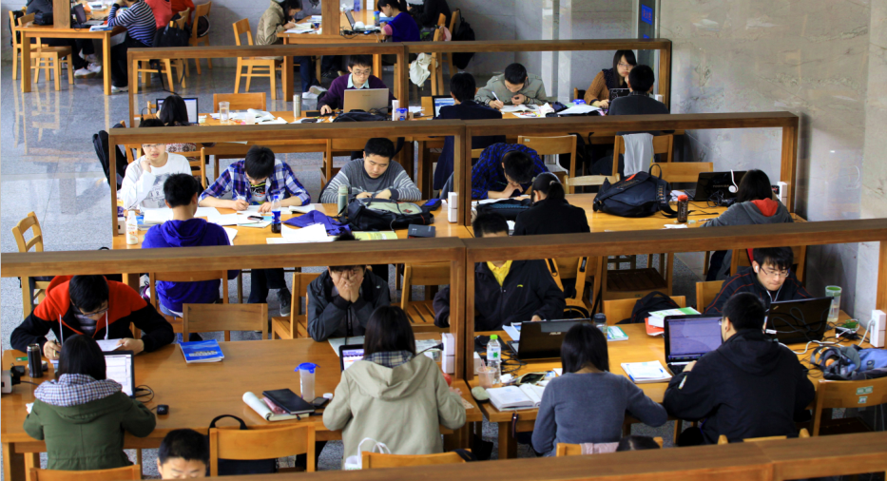
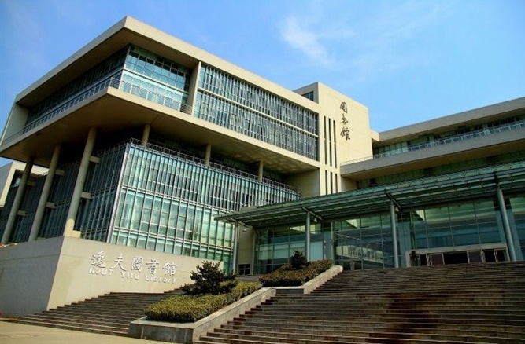
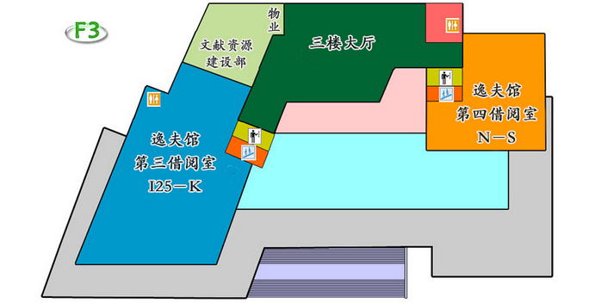
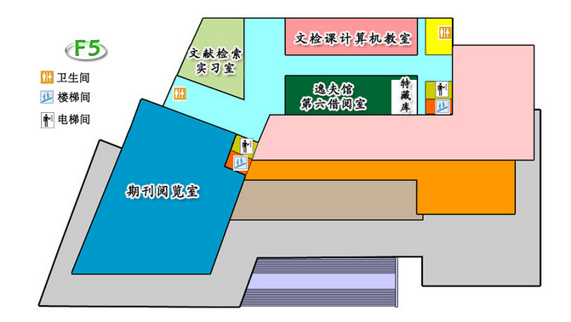
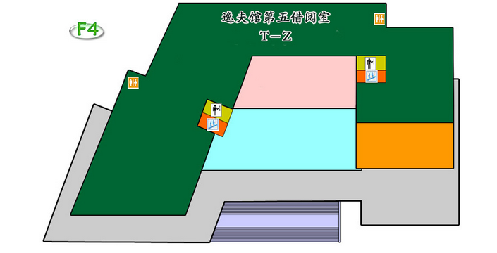
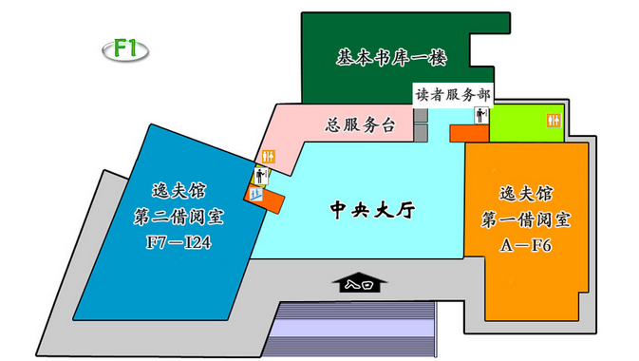
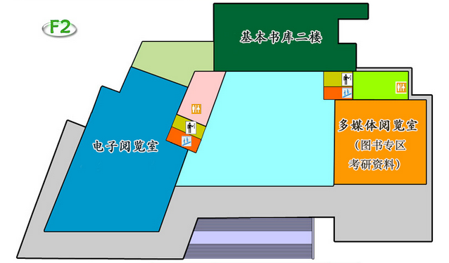
NJTECH LIBRARY
Yi Fu Lib
8:00-22:00

Slide 14
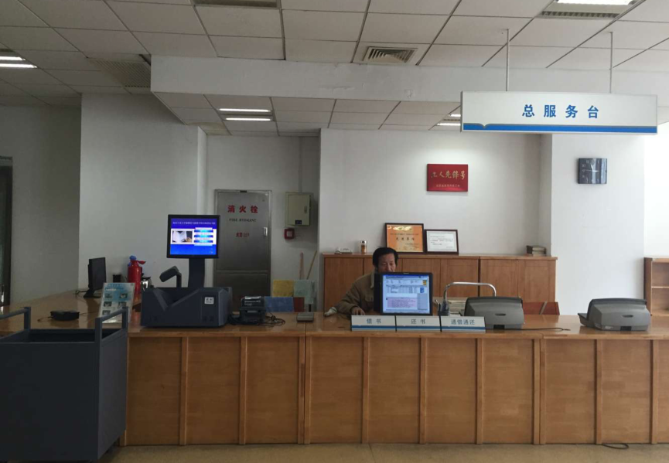
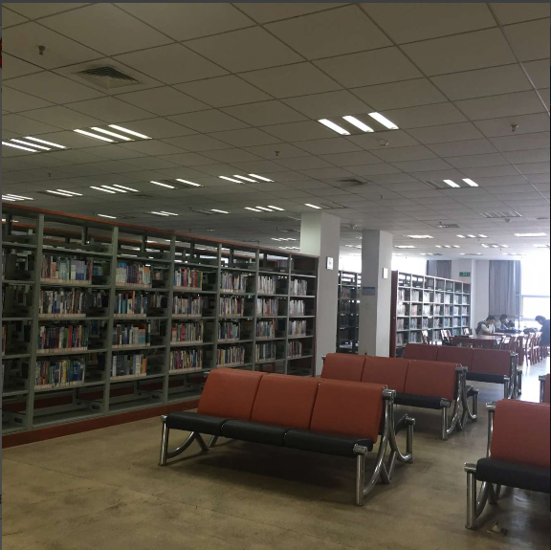
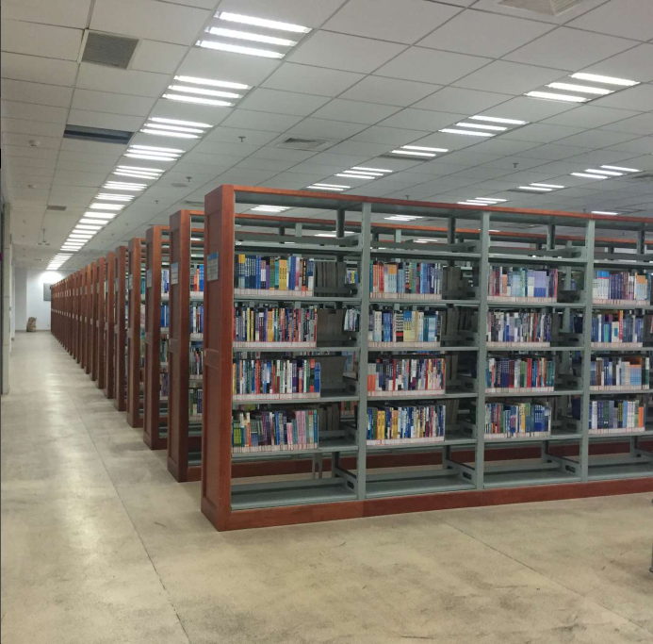
NJTECH LIBRARY
Ding Jia Qiao Lib (Old Campus)

Slide 15
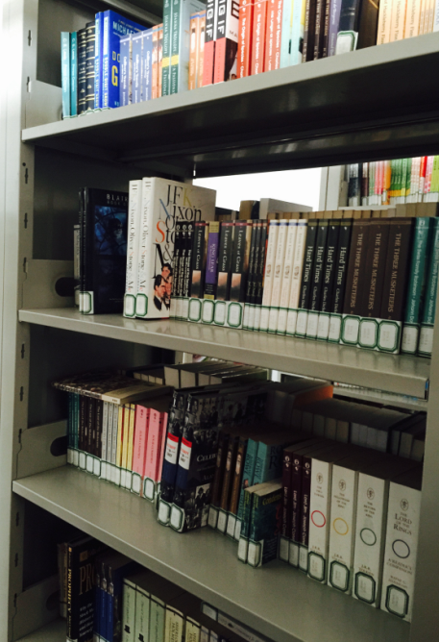
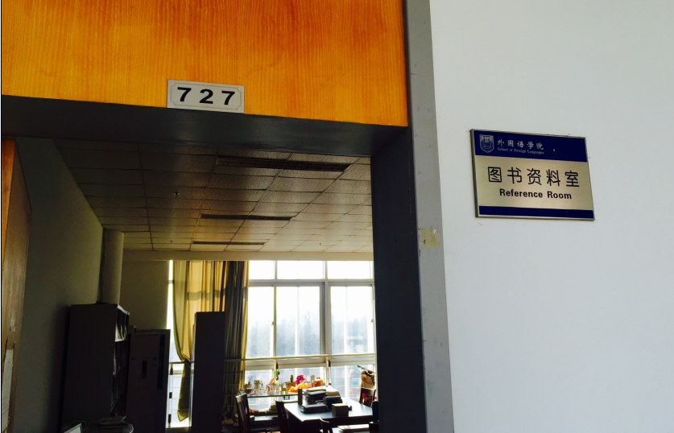
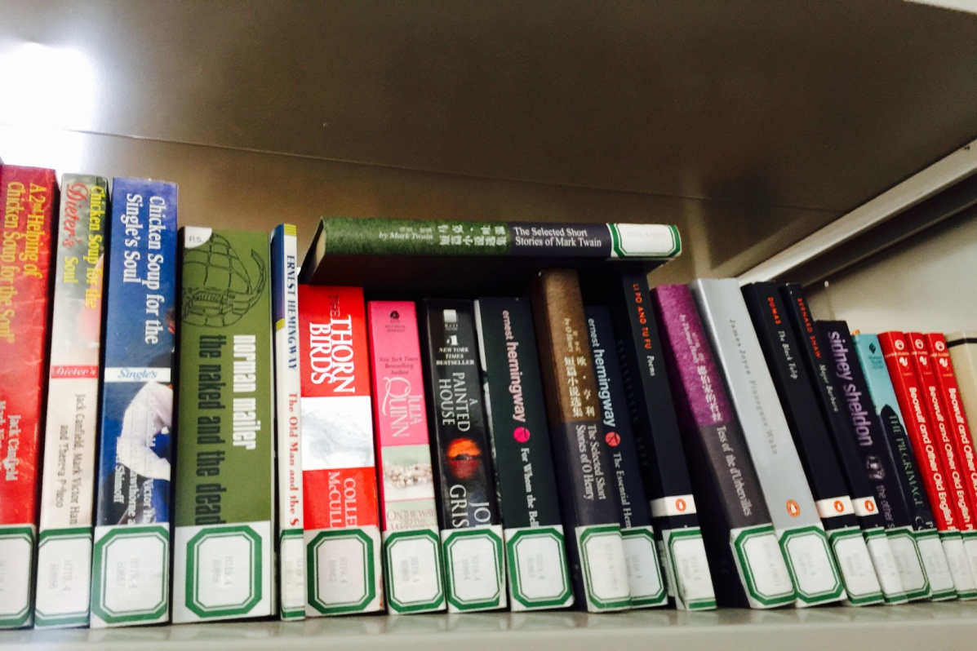
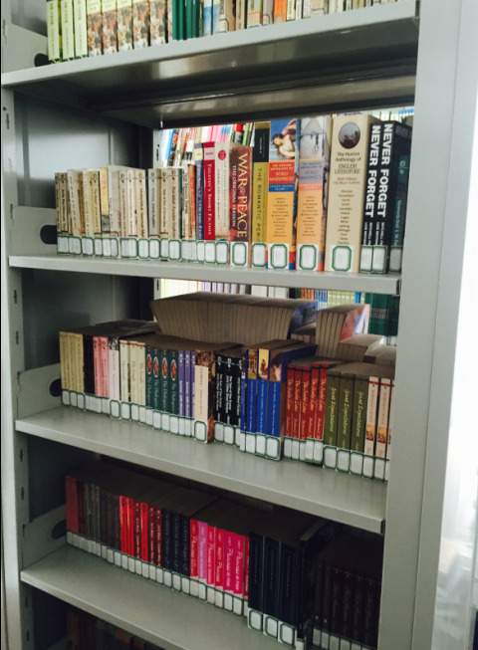
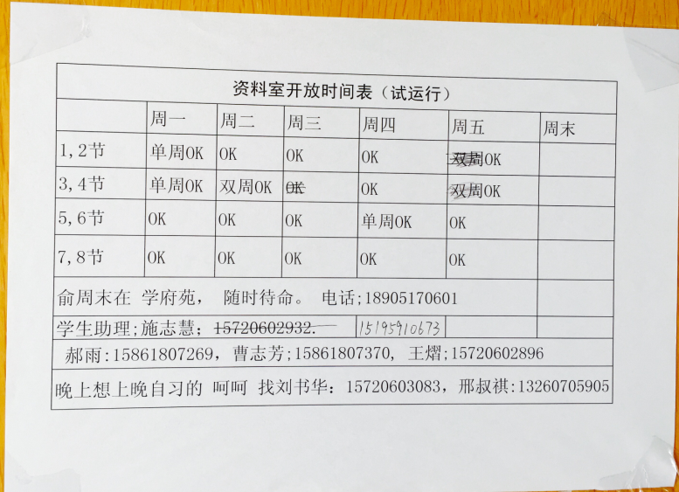
NJTECH LIBRARY
School of Foreign Languages Lib

Slide 16
NJTECH LIBRARY
Liberal Arts Lib

Slide 17
Borrow a book…

Slide 18
Entrance
GATE: 1st or 3rd floor.
You have to swipe your student card. Do not forget to take your student card with green cover.
！！！！！！！！！！！Without the
registration
U cannot enter our library
U cannot borrow any book.

Slide 19
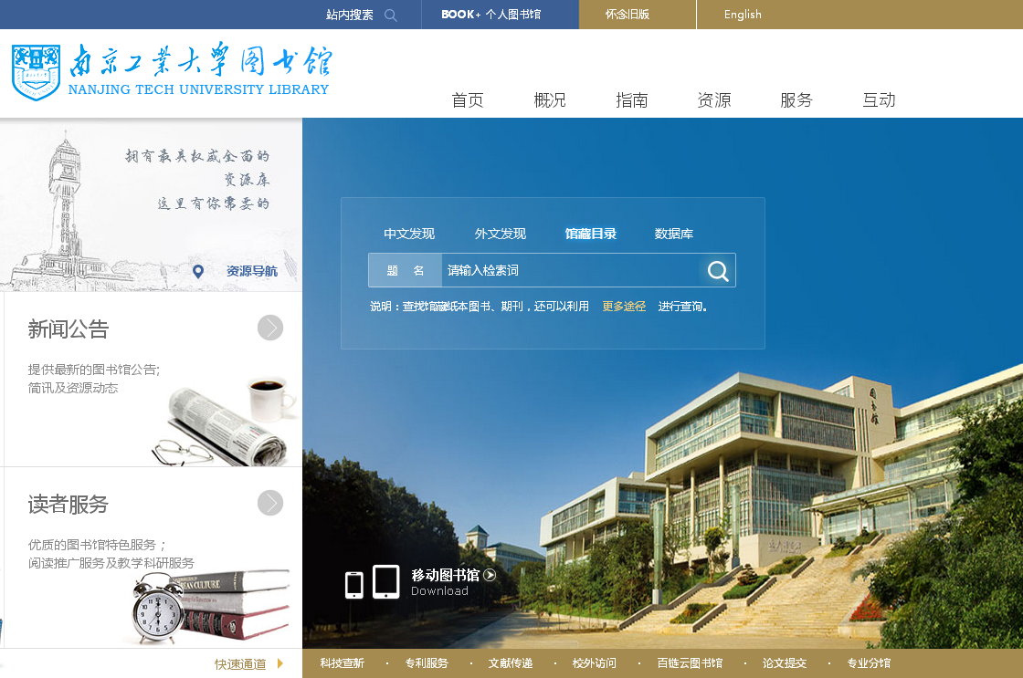
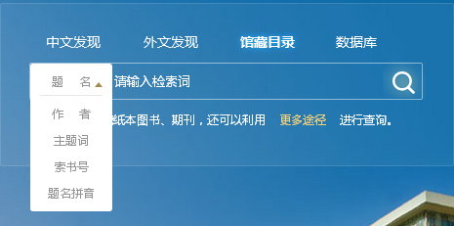
Borrow a book
WE DON’T HAVE ENGLISH VERSION.
Step 1 : OPAC(Online Public Access Catalog)
BOOKS COLLECTION
Homepage: http://lib.njtech.edu.cn/

Slide 20
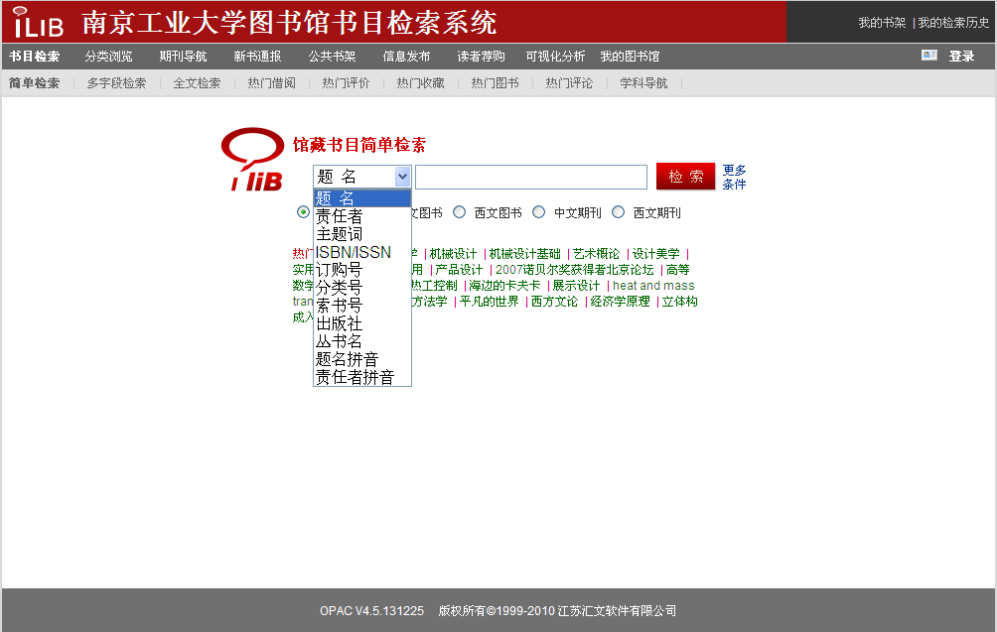
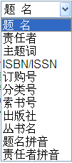
Borrow a book
Step 1 : OPAC
Title
Author
Key words
Call number
Title Pin Yin
Author Pin Yin

Slide 21
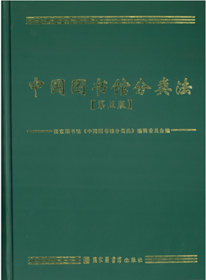
Borrow a book
Step 1 : OPAC
Call number
Chinese Library Classification

Slide 22
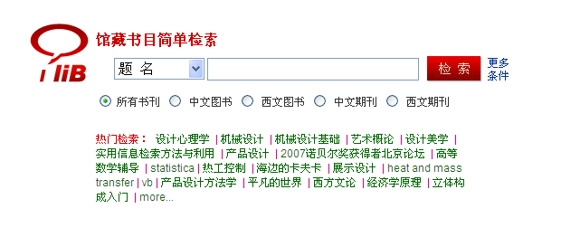
Borrow a book
Step 1 : OPAC

Slide 23
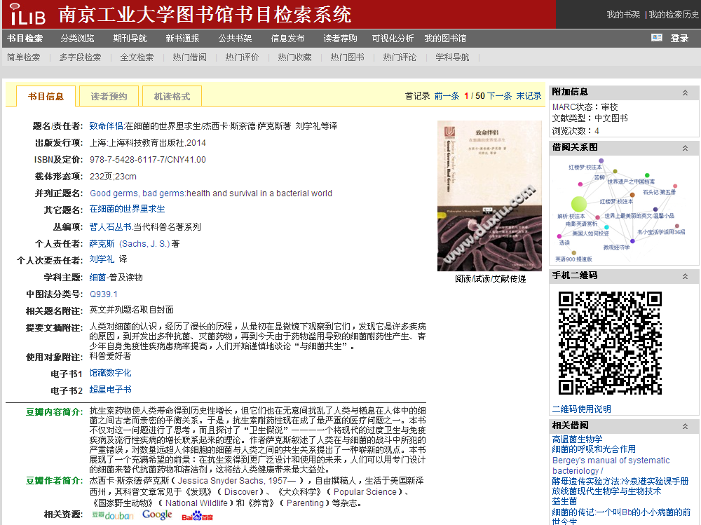
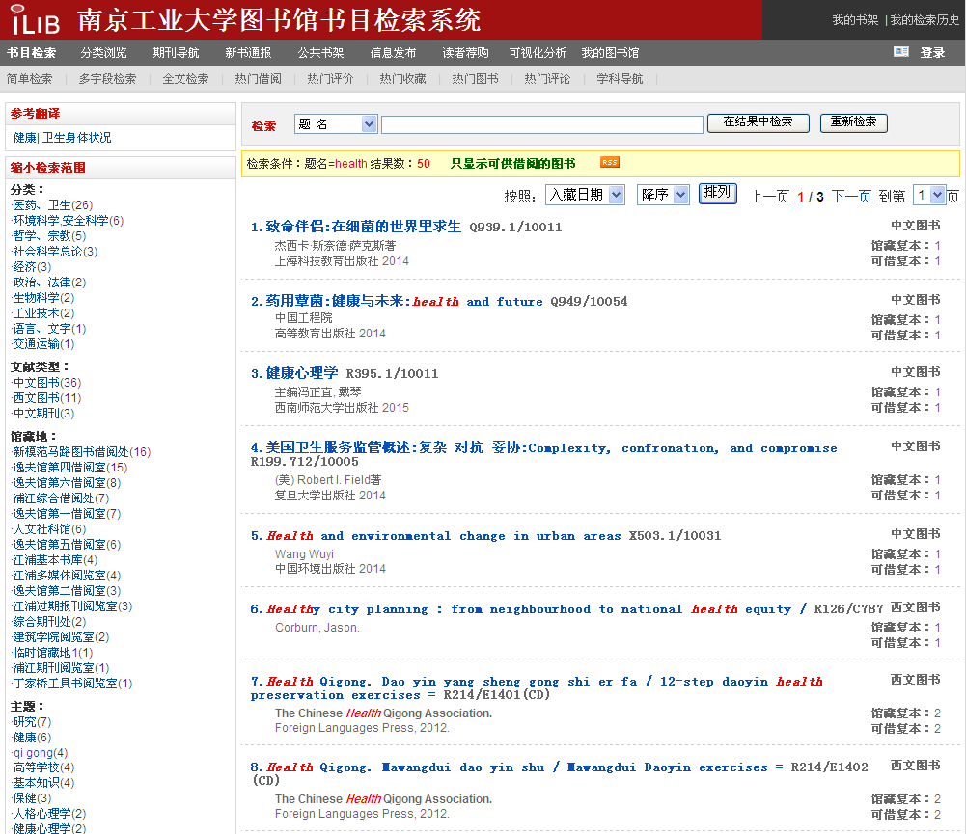
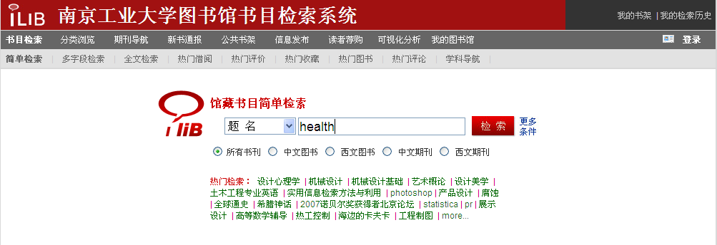
Borrow a book
Step 1 : OPAC

Slide 24
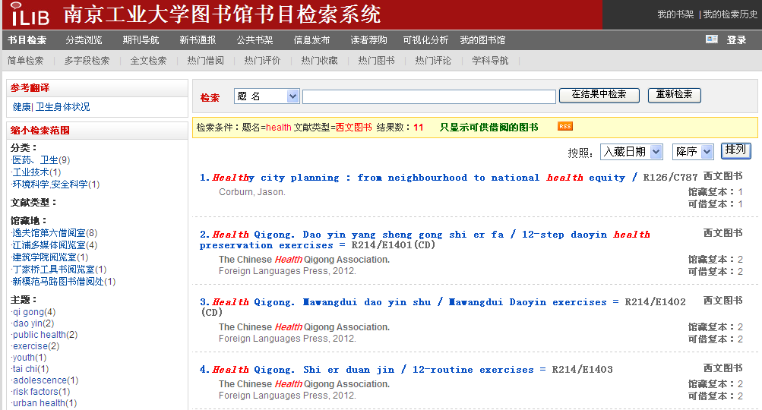
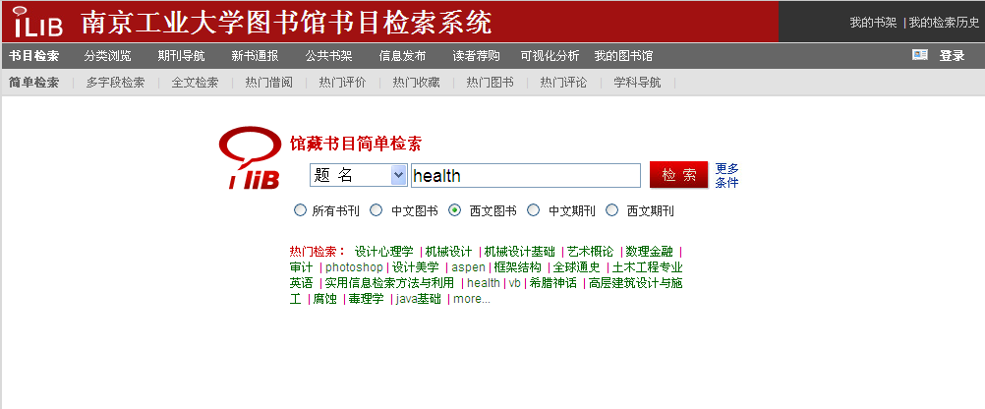
Borrow a book
Step 1 : OPAC

Slide 25
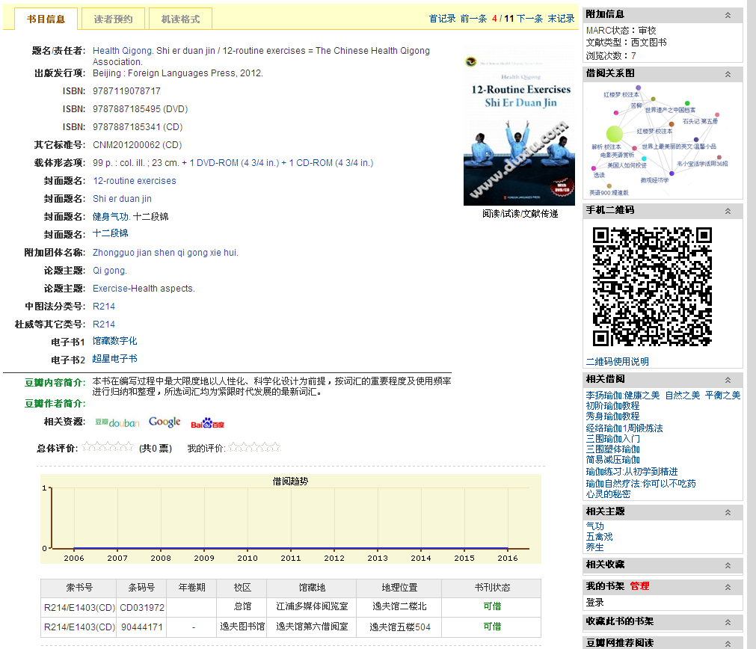
Borrow a book
Step 1 : OPAC
Suo shu hao

Slide 26
Borrow a book
Step 2 : Find & Borrow

Slide 27
Borrow a book
Step 2 : Find & Borrow
Self-service book borrowing and returning machine
1st and 3rd floor

Slide 28
Borrow a book
Step 2 : Find & Borrow
Information desk
1st floor

Slide 29
Return a book…

Slide 30
Return a book
Self-service book returning machine
1st floor
24 hours ( soon )

Slide 31
Return a book

Slide 32
Journals
5th Floor
ONLY READING

Slide 33
Rules and regulation
No food, no smoking.
No campus card, no permission for entrance.
Bachelor degree can hold the books for 30 days, and the allowed borrowing quantity is 8 .
Fine: overdue 1 day: 1 Mao

Slide 34
Notice
江浦 Jiang Pu
丁家桥 Ding Jia Qiao
外语学院 Wai Yu Xue Yuan
创客空间 Chuang Ke Kong Jian: maker spaces
可借 Ke Jie ：for lending
阅览 Yue Lan : for reading
一/二/三/四/五/六楼 Lou : 1st/2nd/3rd/4th/5th/6th Floor

Slide 35
My regulation

Slide 36
My regulation
Attendance 20%
Homework 40%
Final exam 40%

Slide 37
Questions?
How do you recently get books for reading?
Give a list of books you want to read the most. (At least 8)

Slide 38
E-book

Slide 39
E-book
Bai Lian Yun
Tu Shu Guan (Library)

Slide 40
all
books
Wai wen sou suo

